Slide 1
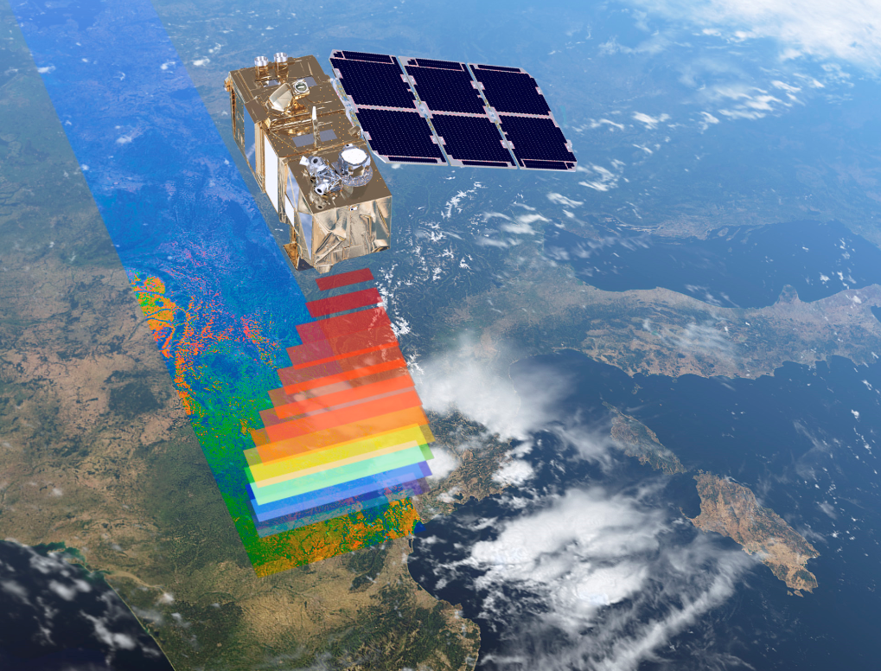
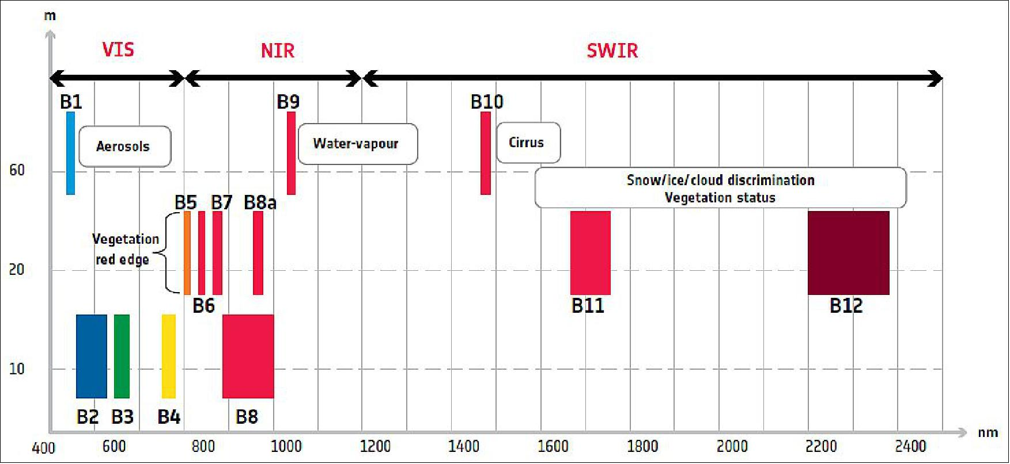
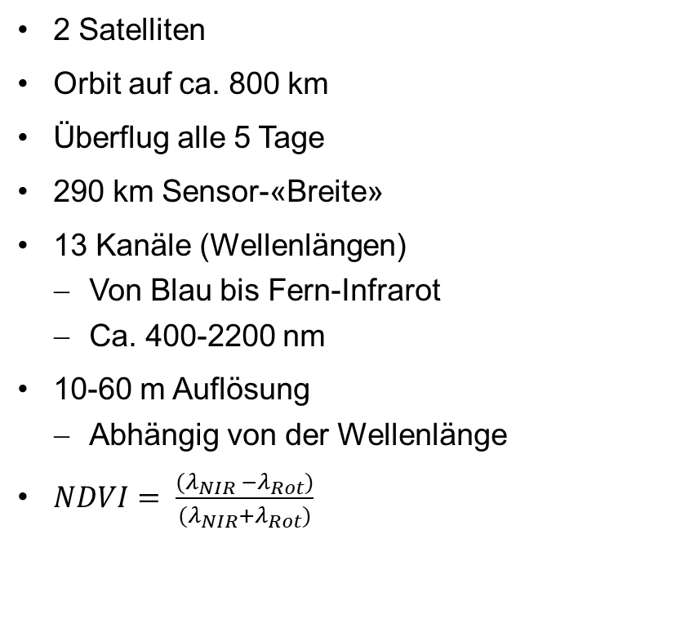
Die Sentinel-2 Satelliten
2 Satelliten
Orbit auf ca. 800 km
Überflug alle 5 Tage
290 km Sensor-«Breite»
13 Kanäle (Wellenlängen)
Von Blau bis Fern-Infrarot
Ca. 400-2200 nm
10-60 m Auflösung
Abhängig von der Wellenlänge
$NDVI= \frac{(λ_{NIR} −λ_{Rot})}{(λ_{NIR}+λ_{Rot})}$

Slide 2
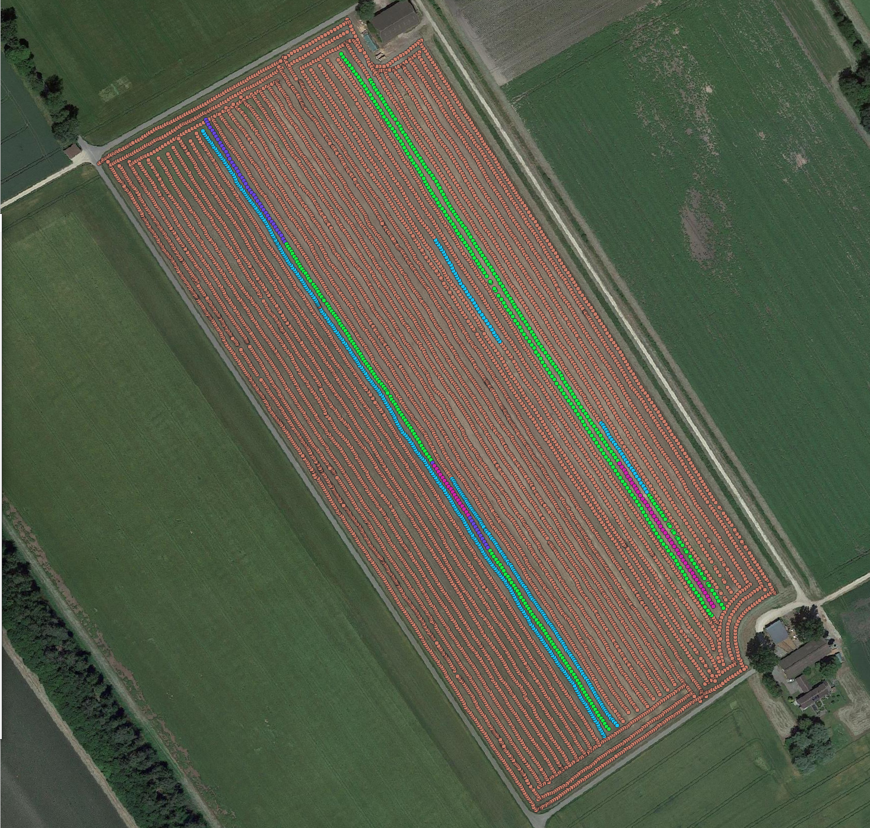
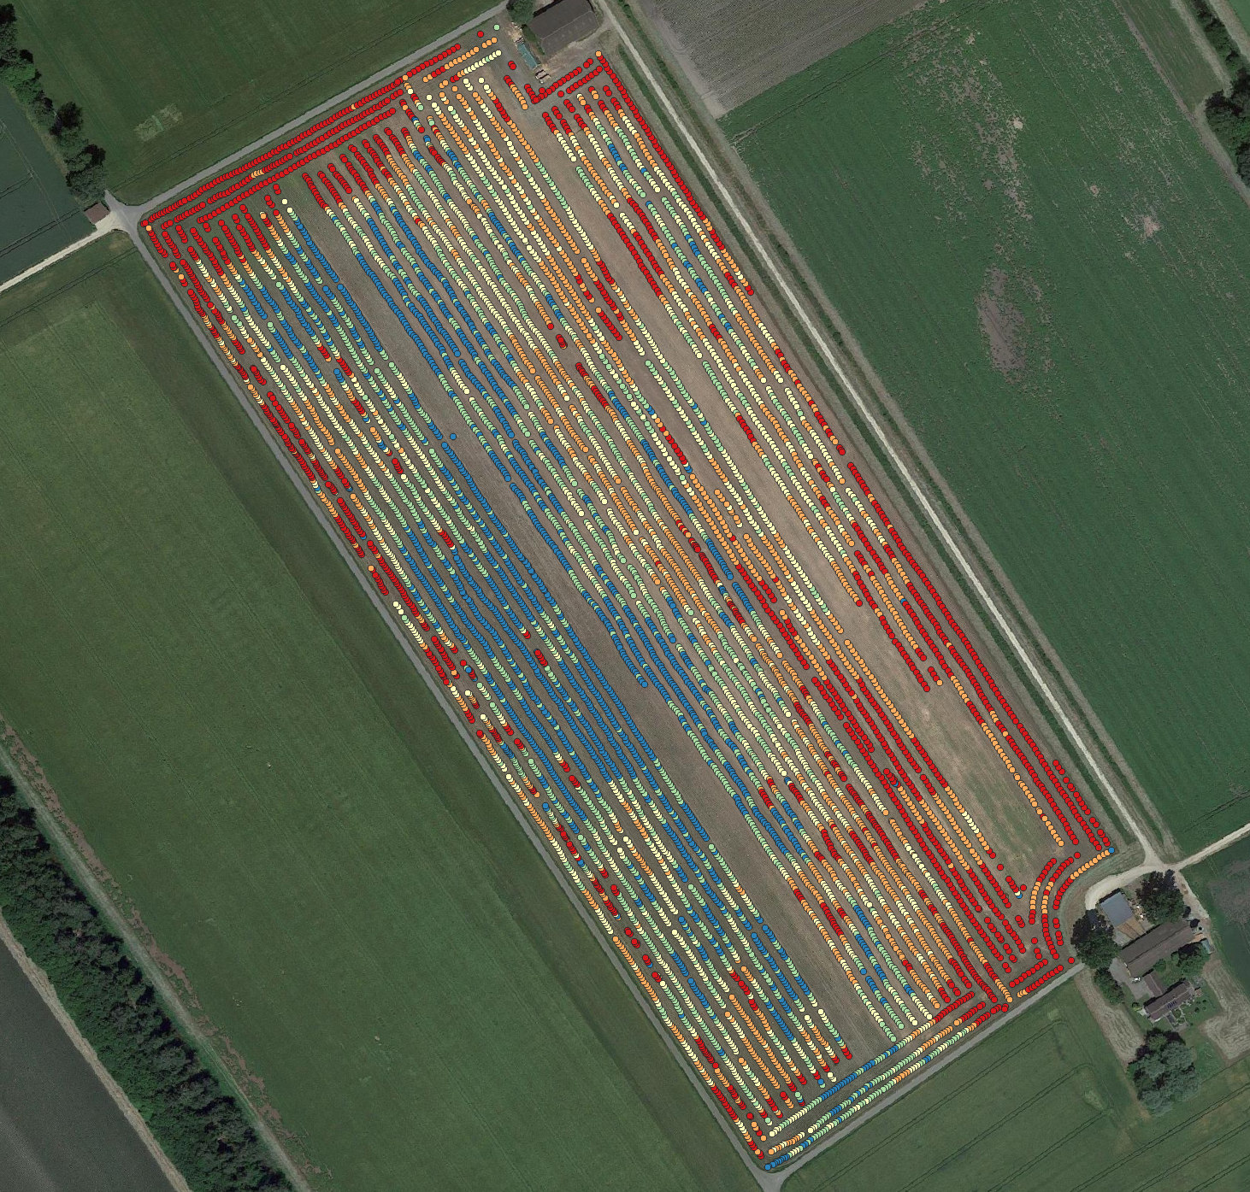
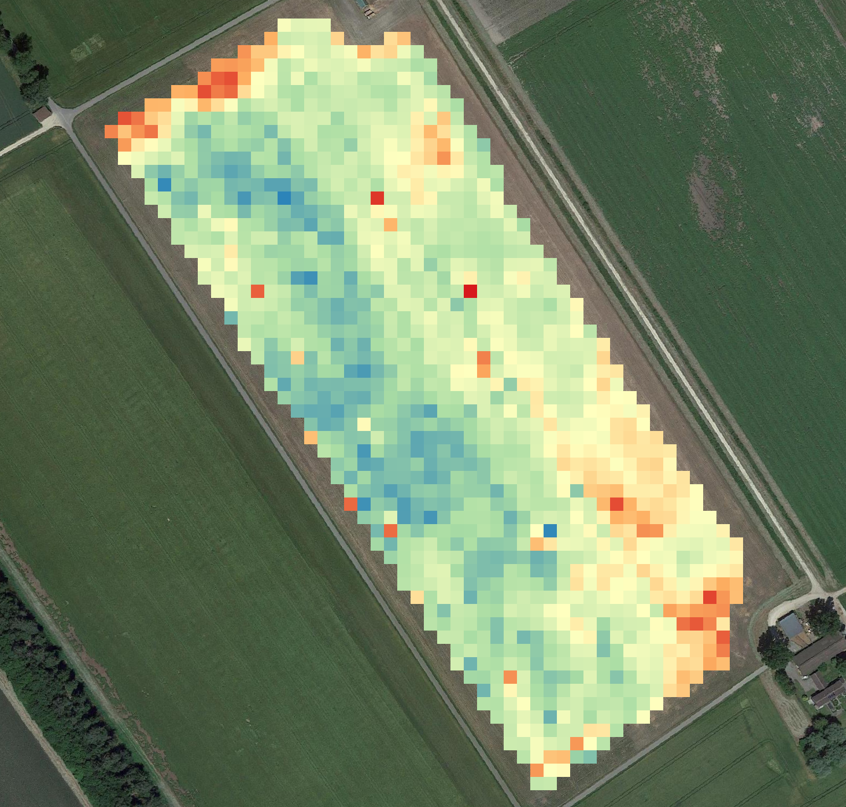
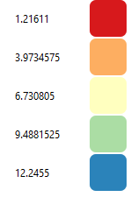
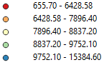
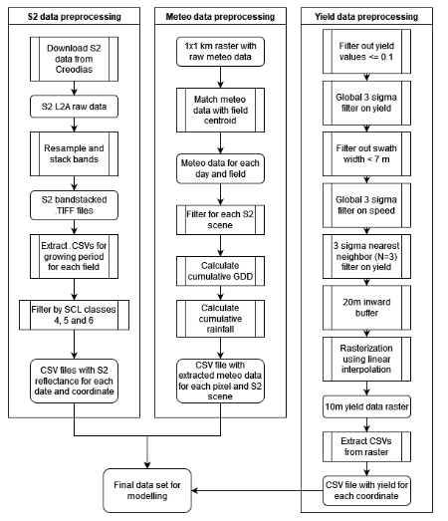
Data processing
Filter zero yield values
‘Global’ 3 sigma filter on yield
Filter swathwidth <7.0 m
‘Global’ 3 sigma filter on speed
‘Local’ 3 NN filter on yield
20 m inward buffer
Rasterization using linear interpolation
10 m resolution (similar to S2)

Slide 3
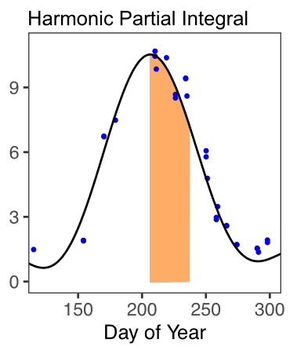
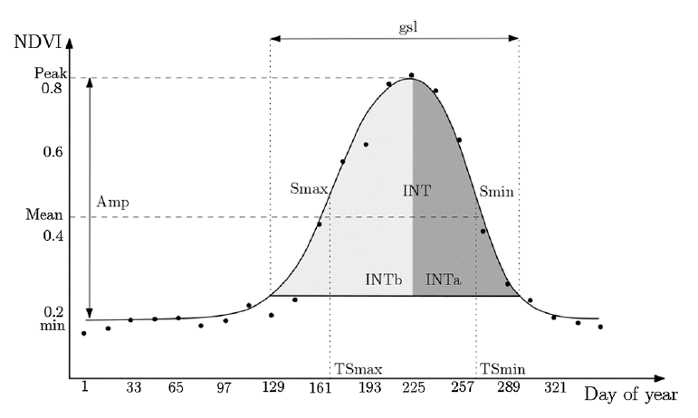
Methods
«Key crop growth window» approach by Deines et al. 2021:
Smoothing of GCVI series using Fourier series
Extraction of features at the peak of the GCVI curve
RFR
«Brute force» approach by Hunt et al. 2019:
Arbitrary selection of 4 S2 scenes
Direct use of S2 band reflectance in Random forest regression (RFR)
Smoothed NDVI & RFR:
Smoothing of NDVI series using B-Splines
Extraction of features along the whole index series
RFR
Recurrent neural network (RNN)
256 hidden layers
Adapted from Turkoglu et al. 2021
«key crop growth window» used by Deines et al. 2021
Smoothed NDVI time series (Figure from Kamir et al. 2020)

